Slide 1
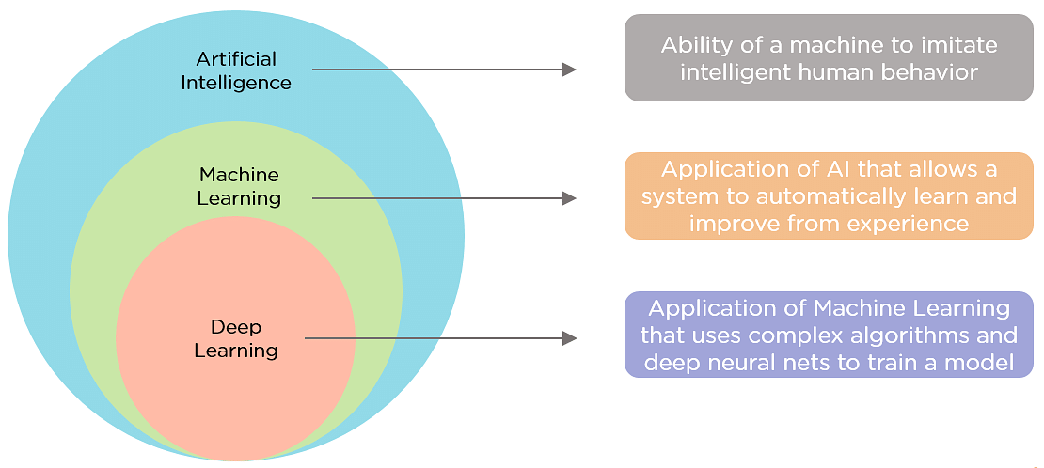
Chapter 1: Introduction to Machine learning
What is the difference between Machine Learning ,Artificial Intelligence and Deep Learning

Slide 2
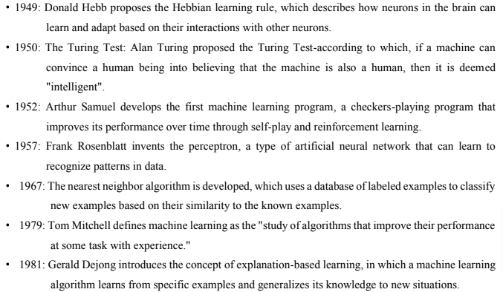
History of Machine Learning
Some major milestones and developments in the history of machine learning

Slide 3
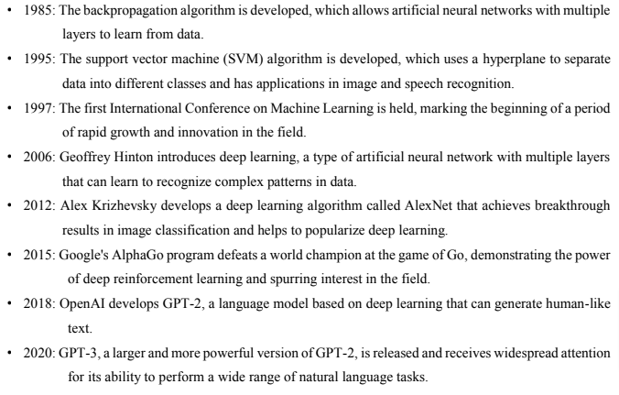

Slide 4
Machine learning
Arthur Samuel, an early American leader in the field of computer gaming and artificial intelligence, coined the term “Machine Learning” in 1959 while at IBM. He defined machine learning as “the field of study that gives computers the ability to learn without being explicitly programmed.”
Other definition
Machine Learning, often abbreviated as ML, is a subset of artificial intelligence (AI) that focuses on the development of computer algorithms that improve automatically through experience and by the use of data. In simpler terms, machine learning enables computers to learn from data and make decisions or predictions without being explicitly programmed to do so.
In traditional programming, a computer follows a set of predefined instructions to perform a task. However, in machine learning, the computer is given a set of examples (data) and a task to perform, but it's up to the computer to figure out how to accomplish the task based on the examples it's given.

Slide 5
For instance, if we want a computer to recognize images of cats, we don't provide it with specific instructions on what a cat looks like. Instead, we give it thousands of images of cats and let the machine learning algorithm figure out the common patterns and features that define a cat. Over time, as the algorithm processes more images, it gets better at recognizing cats, even when presented with images it has never seen before.
This ability to learn from data and improve over time makes machine learning incredibly powerful and versatile. It's the driving force behind many of the technological advancements we see today, from voice assistants and recommendation systems to self-driving cars and predictive analytics

Slide 6
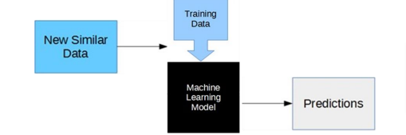
How machine learning works

Slide 7
Collecting Data
Preparing Data
Choosing a Model
Training the Model
Evaluating the Model
Improving the Model
Making Predictions

Slide 8
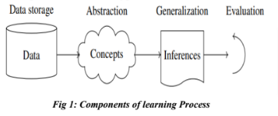
Basic Components of learning process
The learning process, whether by a human or a machine, can be divided into four components namely; data storage, abstraction, generalization and evaluation.
Data Storage
Facilities for storing and retrieving huge amounts of data are an important component of the learning process
in human being, the data is stored in the brain and data is retrieved using electrochemical signals.
Computers use hard disk drives, flash memory, random access memory and similar devices to store data and use cables and other technology to retrieve data

Slide 9
2. Abstraction
The second component of the learning process is known as abstraction. Abstraction is the process of extracting knowledge about stored data. This involves creating general concepts about the data as a whole. The creation of knowledge involves application of known models and creation of new models. The process of fitting a model to a dataset is known as training when the model has been trained, the data is transformed into an abstract form that summarizes the original information.
3. Generalization
The third component of the learning process is known as generalization. The term generalization describes the process of turning the knowledge about stored data into a form that can be utilized for future action. In generalization, the goal is to discover those properties of the data that will be most relevant to future tasks.
4. Evaluation
Evaluation is the last component of the learning process. It is the process of giving feedback to the user to measure the utility of the learned knowledge. This feedback is then utilized to effect improvements in the whole learning process.

Slide 10
Different forms of data
Numeric data
This type of data consists of numbers and can include continuous values (such as prices or temperatures) or discrete values (such as counts or rankings). Numeric data can be used as input or output in machine learning algorithms
2. Categorical / nominal data
This type of data consists of categories or labels, such as names, types, or categories. Categorical data can be used as input or output in machine learning algorithms, but it may need to be converted into a numerical form in order to be used by certain algorithms.
3. Ordinal data
This denotes a nominal variable with categories falling in an ordered list. Examples include clothing sizes such as small, medium, and large, or a measurement of customer satisfaction on a scale from “not at all happy” to “very happy.”

Slide 11
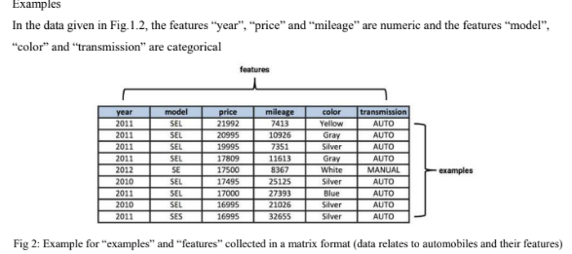

Slide 12
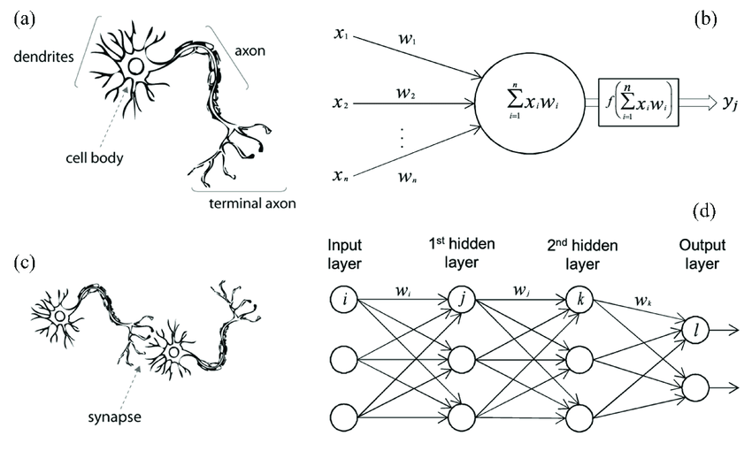
Brain- neuron learning system
Biological neuron VS Artificial neuron

Slide 13
The inspiration for neural networks comes from the extraordinary architecture of the brain.
Biological neurons are cells that process and transmit information in the brain and nervous system.
Artificial Neurons, also known as nodes or units, are the building blocks of neural networks. These computational units are designed to simulate the behavior of biological neurons.
In artificial neural networks, each neuron is represented by a node that takes in input signals from other nodes through weighted connections.
The input signals are transformed by an activation function to determine whether the neuron should fire an output signal.
Learning in both biological and artificial neural networks occurs through the strengthening or weakening of the connections between neurons.
In biological neurons, this is achieved through synaptic plasticity.
In artificial neural networks, this is achieved through training algorithms such as back propagation
The brain neuron learning system is a complex and dynamic process that involves many different factors and mechanisms

Slide 14
Definition and Type of learning models
Learning refers to the process of acquiring knowledge, skills, or behaviors through experience, study, or instruction. It is a fundamental aspect of human and animal cognition and is also a key area of study in machine learning and artificial intelligence.
The different types of learning models mentioned
Learning Models
Machine learning models are algorithms or mathematical representations that are trained on data to make predictions or perform specific tasks. Here are some commonly used machine learning models:
Linear Regression: A model used for regression tasks, where the goal is to predict a continuous numerical value based on input feature. It assumes a linear relationship between the features and the target variable.
Logistic Regression: A model used for binary classification tasks, where the goal is to predict one of two classes. It estimates the probability of the input belonging to a certain class using a logistic function.

Slide 15
3. Decision Trees: A model that uses a tree- like structure to make decisions based on feature values. Each internal node represents a decision based on a feature, and each leaf node represents a predicted class or value.
4. Random forest: An ensemble model that combines multiple decision trees to make predictions. It aggregates the predictions of individual trees to produce a final prediction.
5. Support Vector Machines(SVM): A model that separates data points into different classes using hyperplanes in high- dimensional spaces. It aims to maximize the margin between classes
6. Neural Networks: Deep learning models composed of interconnected layers of artificial neurons. They can learn complex patterns and relationships from data, making them suitable for tasks such as image recognition and natural language processing.
7. Naïve Bayes: A probabilistic model based on Bayes; theorem that assumes independence among features . It is commonly used for text classification tasks such as spam detection and sentimental analysis.

Slide 16
8. K-nearest Neighbors(KNN): A model that classifies data points based on the classes of their nearest neighbors. It assigns a new point to the majority class among its k nearest neighbors.
9. Gradient Boosting Models: Ensemble models that combine multiple weak learners(typically decision trees) to create a strong learner. Examples include Gradient Boosting Machines (GBM), XGBoost, and lightGBM.
10. Hidden Markov Models(HMM): A statistical model used for sequence data, where the underlying system is assumed to be a Markov process with hidden stats. HMMs are widely used in speech recognition and bioinformatics
These are just a few examples of machine learning models, and there are many more algorithms and variations available depending on the specific problem and data characteristics. Each model has its strengths, limitations, and suitability for different types of tasks.

Slide 17
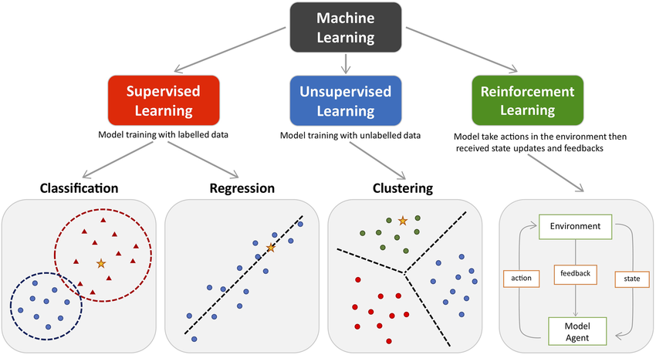
Different types of learning
Machine learning algorithms can be classified into three types

Slide 18
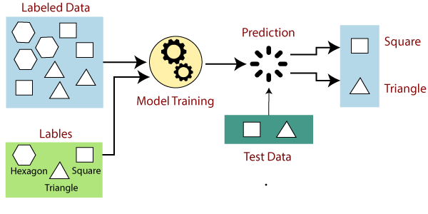
Supervised Learning
It is a form of machine learning in which the algorithm is trained on labeled data to make predictions or decisions based on the data inputs. In supervised learning, the algorithm learns a mapping between the input and output data. This mapping is learned from a labeled dataset, which consists of pairs of input and output data. The algorithm tries to learn the relationship between the input and output data so that it can make accurate predictions on new, unseen data.

Slide 19
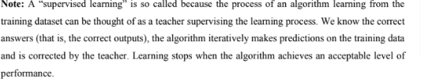
There are two main categories of supervised learning that are mentioned below:
Classification
Regression
Classification
Classification deals with predicting categorical target variables, which represent discrete classes or labels. For instance, classifying emails as spam or not spam, or predicting whether a patient has a high risk of heart disease. Classification algorithms learn to map the input features to one of the predefined classes.
Here are some classification algorithms:
Logistic Regression
Support Vector Machine
Random Forest
Naive Bayes
Regression
Regression, on the other hand, deals with predicting continuous target variables, which represent numerical values. For example, predicting the price of a house based on its size, location, and amenities, or forecasting the sales of a product. Regression algorithms learn to map the input features to a continuous numerical value.
Here are some regression algorithms:
Linear Regression
Polynomial Regression

Slide 20
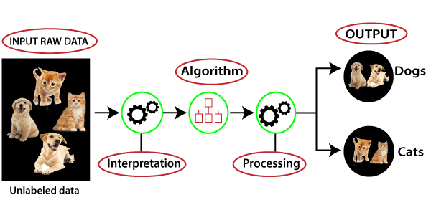
Unsupervised Learning
Unsupervised learning is a type of machine learning technique in which an algorithm discovers patterns and relationships using unlabeled data. Unlike supervised learning, unsupervised learning doesn’t involve providing the algorithm with labeled target outputs. The primary goal of Unsupervised learning is often to discover hidden patterns, similarities, or clusters within the data, which can then be used for various purposes, such as data exploration, visualization, dimensionality reduction, and more.
The most common unsupervised learning method is cluster analysis, which is used for exploratory data analysis to find hidden patterns or grouping data.

Slide 21
Example: Consider that you have a dataset that contains information about the purchases you made from the shop. Through clustering, the algorithm can group the same purchasing behavior among you and other customers, which reveals potential customers without predefined labels.
Reinforcement learning
In a Reinforcement learning there is a learner and a decision maker called agent and the surrounding with which it interacts called environment.
The environment, in return, provides reward and a new state based on the actions of the agent.
So, in the reinforcement learning, we do not teach an agent how it should do something but presents it with rewards whether positive or negative based on the actions.

Slide 22
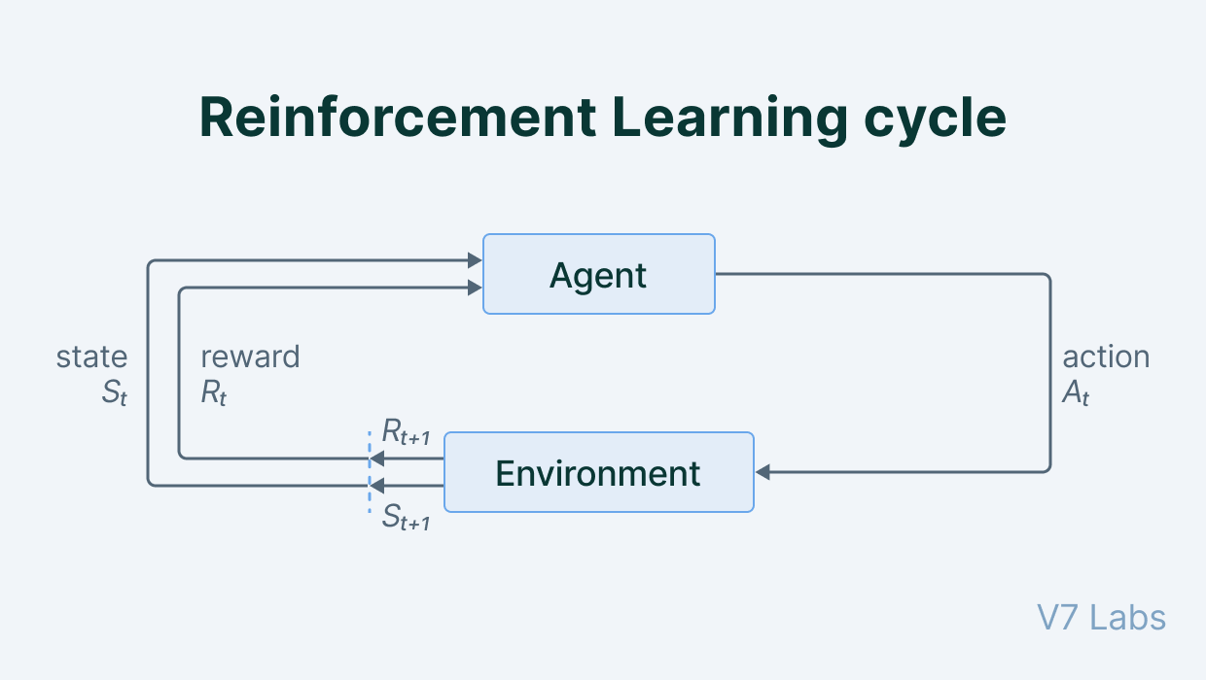
For example, consider teaching a dog a new trick we cannot tell it what to do, but we can reward/punish it if it does right/wrong thing. It has to find out what it did the made it get the reward/punishment.

Slide 23
Need of Machine Learning
1. Automation of Tasks:
Reduces the need for manual intervention in repetitive tasks.
Increases efficiency and productivity across various industries.
2. Data-Driven Decision Making:
Processes large volumes of data to provide actionable insights.
Enhances the accuracy and speed of decision-making processes.
3. Personalization:
Machine learning has enabled personalized experiences in various fields, such as online shopping, entertainment, and healthcare. b
By analyzing user data and behavior, machine learning algorithms can provide personalized recommendations, suggestions, and treatment plans. Common in recommendation systems used by platforms like Netflix and Amazon.
4. Handling Complex Problems:
Solves complex problems that are infeasible with traditional methods.
Examples include natural language processing, autonomous driving, and climate modeling.

Slide 24
5. Improved Accuracy
Machine learning algorithms can often achieve higher accuracy than traditional statistical models in tasks such as prediction, classification, and clustering.
This is because they can learn from large amounts of data and adapt to changing circumstances, resulting in more accurate and reliable predictions.
6. Enhanced Security:
Improves cybersecurity measures by detecting anomalies and potential threats.
Used in surveillance and fraud detection systems.

Slide 25
Data and Tools
Data and tools are essential components of machine learning
Data
Data is the raw material that machine learning algorithms use to learn patterns, make predictions, and perform other tasks.
Good quality data is essential for machine learning, as the accuracy and effectiveness of the algorithms depend on the quality of the data used to train them.
In machine learning data is typically divided into training, validation, and testing sets.
The training set is used to train the machine learning algorithms, while the validation set is used to evaluate the performance of the algorithm during training. The testing set is used to evaluate the performance of the final model
Tools
Tools are software programs and libraries that are used to implement machine learning algorithms and analyze data. There are several popular machine learning.

Slide 26
Programming Languages
Python: Python is a popular programming language for machine learning, with many libraries and frameworks such as NumPy, Pandas, and Scikit-Learn, which provide data analysis, machine learning algorithms, and data visualization capabilities.
R: R is a programming language and environment for statistical computing graphics, widely used in machine learning and data science. It provides many packages for data manipulation, visualization, and machine learning.
Frameworks and libraries
TensorFlow: Tensorflow is an open-source machine learning library developed by google, which provides a wide range of machine learning algorithms and tools for deep learning, natural language processing, and computer vision
PyTorch: PyTorch is an open-source machine learning library developed by Facebook, which provides a flexible platform for building and training machine learning models, including deep neural networks.
Scikit-Learn: A comprehensive library for classical machine learning algorithms. Includes tools for data preprocessing, model selection, and evaluation.

Slide 27
Integrated Development Environments(IDEs)
Jupyter Notebook: Jupyter notebook is an open-source web application that allows users to create share documents that contain live code, equations, visualization, and narrative text. It is widely used in data science and machine learning for data exploration, experimentation, and visualization.
Google Colab: A free cloud service with support for Jupyter Notebooks. Provides free GPU and TPU resources.
Cloud Services
Google AI Platform: Managed services for training and deploying models. Supports TensorFlow, Keras, and Scikit-Learn.
Amazon SageMaker: Fully managed service for building, training, and deploying ML models. Integrates with other AWS services.
Microsoft Azure ML: Cloud-based environment for machine learning. Supports various frameworks like TensorFlow, PyTorch, and Scikit-Learn.

Slide 28
Review of statistics
Statistics is the study of the collection, analysis, interpretation, presentation and organization of data. It is a crucial tool in various fields, including science, social sciences, business, and engineering, among others.
Here are some of the key aspects of statistics:
Descriptive Statistics: Descriptive statistics is the process of summarizing and describing the properties of data, such as measures of central tendency (mean, median, mode) and measures of variability( standard deviation, variance)
Inferential Statistics: inferential statistics involves making predictions and generalizations about a population based on a sample of data. It uses probability theory and hypothesis testing to determine whether an observed effect is statistically significant.
Probability theory: probability theory is the branch of mathematics that deals with the study of random events and their likelihood of occurance.it is used in statistics to model and predict the outcomes of experiments and observations.

Slide 29
Sampling: Sampling involves selecting a subset of data from a larger population for analysis. In statistics, the quality of the analysis depends on the representativeness of the sample and the sampling method used.
Regression Analysis: Regression analysis is a statistical method used to establish a relationship between a dependent variable and one or more independent variables.
Hypothesis Testing: Hypothesis testing is a statistical method used to determine whether a hypothesis about a population is true or false. It is used in machine learning to evaluate the significance of model performance and determine whether the model is valid.
Statistical Learning: Statistical learning is a type of machine learning that uses statistical methods to analyze data and make predictions. It includes techniques such as linear regression, logistic regression, decision trees, and random forests.
In the machine learning perspective, statistics is a critical component of data analysis, model selection and evaluation. Machine learning algorithms rely on statistical techniques to learn from data and make accurate predictions. Understanding statistics is therefore essential for anyone working in machine learning.

Slide 30
Training, validation and Test data
In machine learning the process of training a model involves using a dataset to teach the model to recognize patterns and make predictions.
However, it is important to evaluate the performance of the model on new, unseen data to ensure that it generalizes well and is not overfitting to the training data.
To achieve this, the dataset is often split into three subsets: training, validation, and test data.
Training Data: The training data is used to train the model, and it typically represents the largest portion of the dataset. The model learns to recognize patterns in the training data and adjust its parameters accordingly.
Validation Data: The validation data is used to evaluate the performance of the model during the training process. It is used to fine-tune the model’s hyper parameters, such as the learning rate or regularization strength, to improve its performance on the validation set.
Test Data: The test data is used to evaluate the final performance of the model after the training process is complete. It represents new, unseen data, and it is used to estimate the model’s performance on new data that it has not seen during training.

Slide 31
Theory of Learning
The theory of learning in machine learning is concerned with understanding how machines can learn from data to improve their performance on a given task.
Here are some key concepts in the theory of learning:
Feasibility of Learning: Feasibility of learning refers to the question of whether a particular learning problem can be solved algorithmically. Some learning problems are inherently difficult and cannot be solved efficiently, while others can be solved with relatively simple algorithms.
Error and noise: In machine learning, error refers to the difference between the predicted output of a model and the true output. Noise refers to the random variation in the data that is not related to the underlying patterns that the model is trying to learn. To build a good model, it is important to reduce both error and noise in the data.
Training versus Testing: Training refers to the process of using a dataset to teach a machine learning model to recognize patterns and make predictions. Testing refers to the process of evaluating the model’s performance on new, unseen data. It is important to test the model on new data to ensure that it generalizes well and is not over fitting to the training data.
In machine learning, the goal is to learn a model that can make accurate predictions on new data.
The process of learning involves finding a function that maps inputs to outputs by minimizing the error between the predicted output and the true output.
However, it is important to balance the complexity of the model with its ability to generalize to new data. Overlay complex model can be overfit to training data and perform poorly on new data. Therefore, it is important to evaluate the model’s performance on new data to ensure that it generalizes well

Slide 32
Generalization
How well a model trained on the training sets predicts the right output for new instances is called generalization. Generalization refers to how well the concepts learned by machine learning model apply to specific examples not seen by the model when it was learning.
Overfitting and Underfitting are the two biggest causes for poor performance of machine learning algorithms. The model should be selected having the best generalization.
Underfitting: Underfitting is the production of machine learning model that is not complex enough to accurately capture relationships between a datasets features and a target variable. Underfitted machine learning model is not suitable model for making predictions because it has poor performance on the training data too.
Overfitting: Overfitting is the production of an analysis which corresponds too closely or exactly to a particular set of data, and may therefore fail to fit additional data or predict future observations reliably. It happens when the model learns the details and noise of the training data this impacts the model’s ability to generalize because these concepts do not apply to new data.

Slide 33
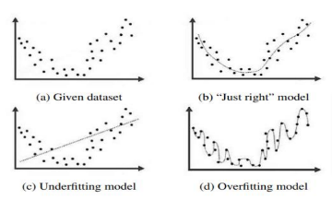

Slide 34
Generalization bound
Generalization bound in machine learning is a concept that quantifies how well a trained model is expected to perform on new, unseen data. It essentially measures the difference between a model’s performance on the training data and its performance on the overall data distribution. Here’s a simple explanation of generalization bound:
Key Concepts
Training Error:
The error rate of the model on the training dataset.
It indicates how well the model has learned the training data.
Generalization Error:
The error rate of the model on new, unseen data.
It reflects the model’s ability to generalize the knowledge gained from the training data to other data from the same distribution.
Overfitting and Underfitting:
Generalization Bound
The generalization bound provides a theoretical guarantee on how close the training error is to the generalization error.
the generalization bound is a theoretical measure that helps understand and control the difference between a model’s performance on training data and its expected performance on unseen data. By managing factors like model complexity, training data size, and regularization, one can improve the generalization capability of machine learning models.

Slide 35
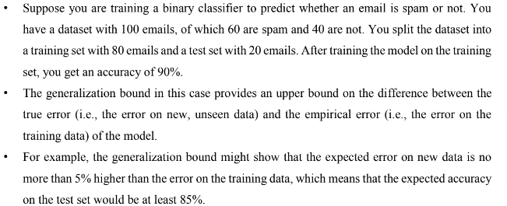
Generalization bound…

Slide 36
Approximation-generalization tradeoff
The approximation-generalization tradeoff is a fundamental concept in machine learning that describes the balance between two competing aspects of model performance: the ability to fit the training data (approximation) and the ability to perform well on unseen data (generalization).
The approximation-generalization tradeoff is a fundamental challenge in machine learning, where the goal is to find a model that is both complex enough to capture the underlying patterns in the data and simple enough to generalize well to new, unseen data. Simple models may generalize better, but they may not be able to capture the complexity of the underlying patterns in the data
The approximation-generalization tradeoff is a key challenge in machine learning, as finding the right balance between model complexity and generalization is crucial for building accurate and robust models.

Slide 37
Bias Variance Tradeoff
The prediction error for any machine learning algorithm can be broken down into three parts
Bias Error
Variance Error
Irreducible Error
Bias
Bias is the difference between the average prediction of our model and the correct value which we are trying to predict. A high bias-model is too simple and may underfit the data. Model with high bias pays very less little attention to the training data and oversimplifies the model
Variance
Variance is taken as the variability of a model prediction for a given data point. Model with high variance pays a lot of attention to training data and does not generalize the data which it hasn’t seen before. As a result, such models perform very well on training data but has high error rates on test data. Variance is the result of overfitting.
Bias and variance are two important sources of error in machine learning and understanding how to control them is critical for building models that generalize well.

Slide 38
